Slide 1

Classification (Decision Tree)
by:
Eng. Alaa Al Nissany

Slide 2
Machine Learning
Supervised Learning
Unsupervised Learning
Reinforcement Learning
Classification
Clustering
Q-Learning
Regression
Anomaly Detection
DQN
Ranking
Dimensionality reduction

Slide 3
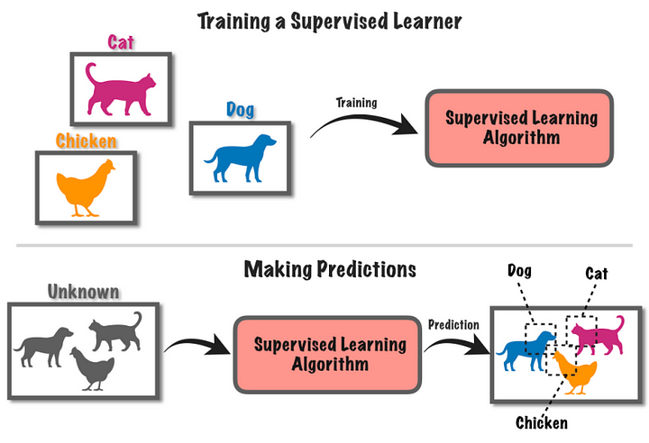
Supervised Learning

Slide 4
Decision Tree

Slide 5
Decision Tree
Root Node
Branch Node
Leaf Node

Slide 6
Impurity
Highly Impure
Low Impure
Pure

Slide 7
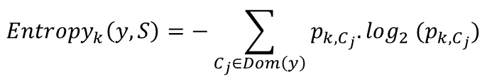
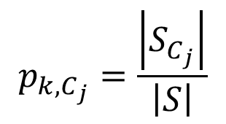
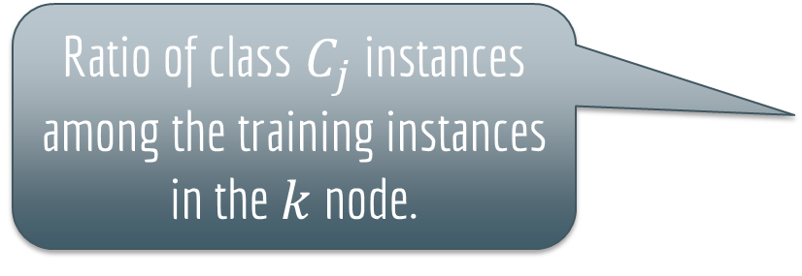
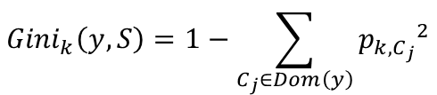
Impurity Index
Gini index
Entropy
$${Gini}_{k}\left(y,S\right)=1−\sum_{C_{j}∈Dom\left(y\right)}{{p_{k,C_{j}}}^{2}}$$
$${Entropy}_{k}\left(y,S\right)=−\sum_{C_{j}∈Dom\left(y\right)}{p_{k,C_{j}}.\log_{2} (p_{k,C_{j}})}$$
Ratio of class $C_{j}$ instances among the training instances in the $k$ node.
$$p_{k,C_{j}}=\frac{\left|S_{C_{j}}\right|}{\left|S\right|}$$

Slide 8
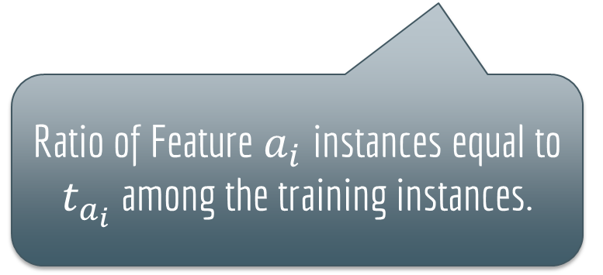
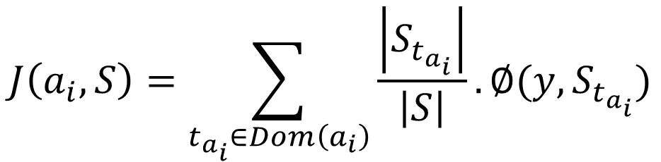
Classification and Regression Tree (CART)
Impurity Index
$$J\left(a_{i},S\right)=\sum_{t_{a_{i}}∈Dom\left(a_{i}\right)}{\frac{\left|S_{t_{a_{i}}}\right|}{\left|S\right|}}.∅(y,S_{t_{a_{i}}})$$
Ratio of Feature $a_{i}$instances equal to $t_{a_{i}}$ among the training instances.

Slide 9
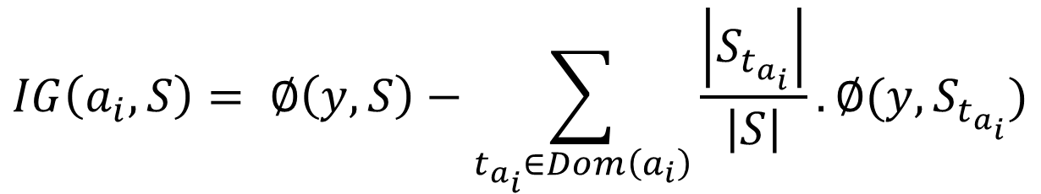
Information Gain
$$IG\left(a_{i},S\right)= ∅\left(y,S\right)−\sum_{t_{a_{i}}∈Dom\left(a_{i}\right)}{\frac{\left|S_{t_{a_{i}}}\right|}{\left|S\right|}}.∅(y,S_{t_{a_{i}}})$$

Slide 10


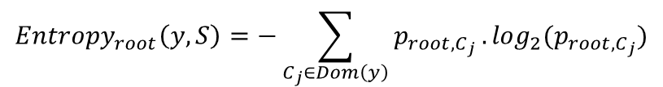
Example
Step 1
Calculate the Entropy of the Whole Dataset
Animal | Color | Size | Cuteness
Dog | Brown | Small | Medium
Cat | Brown | Small | Medium
Dog | Brown | Small | High
Cat | Gold | Medium | High
Cat | Black | Medium | High
Dog | Gold | Small | Medium
Cat | Brown | Medium | Low
Dog | Gold | Large | High
Cat | Brown | Medium | Medium
Dog | Black | Large | High
Cat | Gold | Large | Medium
Cat | Brown | Small | High
5 | 7
$${Entropy}_{root}\left(y,S\right)=−\sum_{C_{j}∈Dom\left(y\right)}{p_{root,C_{j}}}.\log_{2}(p_{root,C_{j}})$$
$=−[p_{root,Dog}.\log_{2}(p_{root,Dog})+p_{root,Cat}.\log_{2}(p_{root,Cat})$]

Slide 11
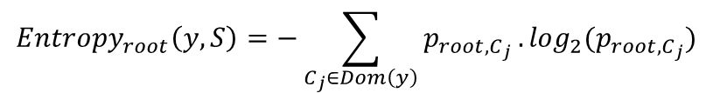
Example
Step 1
Calculate the Entropy of the Whole Dataset
Animal | Color | Size | Cuteness
Dog | Brown | Small | Medium
Cat | Brown | Small | Medium
Dog | Brown | Small | High
Cat | Gold | Medium | High
Cat | Black | Medium | High
Dog | Gold | Small | Medium
Cat | Brown | Medium | Low
Dog | Gold | Large | High
Cat | Brown | Medium | Medium
Dog | Black | Large | High
Cat | Gold | Large | Medium
Cat | Brown | Small | High
5 | 7
$${Entropy}_{root}\left(y,S\right)=−\sum_{C_{j}∈Dom\left(y\right)}{p_{root,C_{j}}}.\log_{2}(p_{root,C_{j}})$$
$=−[\frac{5}{12}.\log_{2}(\frac{5}{12})+\frac{7}{12}.\log_{2}(\frac{7}{12})$] = 0.97986875665

Slide 12
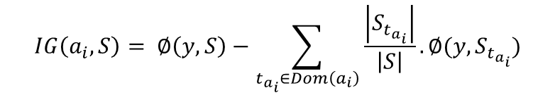
Example
Step 2
Calculate Information Gain for “Colour” Feature
Animal | Color | Size | Cuteness
Dog | Brown | Small | Medium
Cat | Brown | Small | Medium
Dog | Brown | Small | High
Cat | Gold | Medium | High
Cat | Black | Medium | High
Dog | Gold | Small | Medium
Cat | Brown | Medium | Low
Dog | Gold | Large | High
Cat | Brown | Medium | Medium
Dog | Black | Large | High
Cat | Gold | Large | Medium
Cat | Brown | Small | High
Color |  |  | ALL
Brown | 2 | 4 | 6
Black | 1 | 1 | 2
Gold | 2 | 2 | 4
$$IG\left(a_{i},S\right)= ∅\left(y,S\right)−\sum_{t_{a_{i}}∈Dom\left(a_{i}\right)}{\frac{\left|S_{t_{a_{i}}}\right|}{\left|S\right|}}.∅(y,S_{t_{a_{i}}})$$

Slide 13
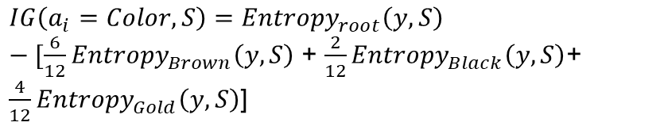
Example
Step 2
Calculate Information Gain for “Colour” Feature
Animal | Color | Size | Cuteness
Dog | Brown | Small | Medium
Cat | Brown | Small | Medium
Dog | Brown | Small | High
Cat | Gold | Medium | High
Cat | Black | Medium | High
Dog | Gold | Small | Medium
Cat | Brown | Medium | Low
Dog | Gold | Large | High
Cat | Brown | Medium | Medium
Dog | Black | Large | High
Cat | Gold | Large | Medium
Cat | Brown | Small | High
Color |  |  | ALL
Brown | 2 | 4 | 6
Black | 1 | 1 | 2
Gold | 2 | 2 | 4
$IG\left(a_{i}=Color,S\right)={Entropy}_{root}\left(y,S\right)−[\frac{6}{12}{Entropy}_{Brown}\left(y,S\right)$ + $\frac{2}{12}{Entropy}_{Black}\left(y,S\right)$+ $\frac{4}{12}{Entropy}_{Gold}\left(y,S\right)$]

Slide 14
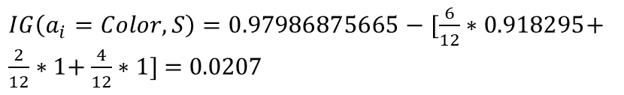
Example
Step 2
Calculate Information Gain for “Colour” Feature
Animal | Color | Size | Cuteness
Dog | Brown | Small | Medium
Cat | Brown | Small | Medium
Dog | Brown | Small | High
Cat | Gold | Medium | High
Cat | Black | Medium | High
Dog | Gold | Small | Medium
Cat | Brown | Medium | Low
Dog | Gold | Large | High
Cat | Brown | Medium | Medium
Dog | Black | Large | High
Cat | Gold | Large | Medium
Cat | Brown | Small | High
Color |  |  | ALL
Brown | 2 | 4 | 6
Black | 1 | 1 | 2
Gold | 2 | 2 | 4
$IG\left(a_{i}=Color,S\right)=0.97986875665−[\frac{6}{12}∗0.918295$+ $\frac{2}{12}∗1$+ $\frac{4}{12}∗1$] = 0.0207

Slide 15
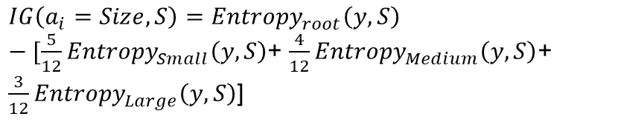
Example
Step 3
Calculate Information Gain for “Size” Feature
Animal | Color | Size | Cuteness
Dog | Brown | Small | Medium
Cat | Brown | Small | Medium
Dog | Brown | Small | High
Cat | Gold | Medium | High
Cat | Black | Medium | High
Dog | Gold | Small | Medium
Cat | Brown | Medium | Low
Dog | Gold | Large | High
Cat | Brown | Medium | Medium
Dog | Black | Large | High
Cat | Gold | Large | Medium
Cat | Brown | Small | High
Size |  |  | ALL
Small | 3 | 2 | 5
Medium | 0 | 4 | 4
Large | 2 | 1 | 3
$IG\left(a_{i}=Size,S\right)={Entropy}_{root}\left(y,S\right)−[\frac{5}{12}{Entropy}_{Small}\left(y,S\right)$+ $\frac{4}{12}{Entropy}_{Medium}\left(y,S\right)$+ $\frac{3}{12}{Entropy}_{Large}\left(y,S\right)$]

Slide 16
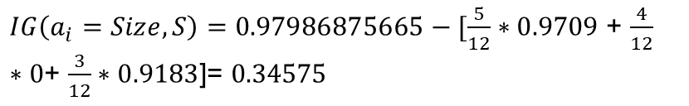
Example
Step 3
Calculate Information Gain for “Size” Feature
Animal | Color | Size | Cuteness
Dog | Brown | Small | Medium
Cat | Brown | Small | Medium
Dog | Brown | Small | High
Cat | Gold | Medium | High
Cat | Black | Medium | High
Dog | Gold | Small | Medium
Cat | Brown | Medium | Low
Dog | Gold | Large | High
Cat | Brown | Medium | Medium
Dog | Black | Large | High
Cat | Gold | Large | Medium
Cat | Brown | Small | High
Size |  |  | ALL
Small | 3 | 2 | 5
Medium | 0 | 4 | 4
Large | 2 | 1 | 3
$IG\left(a_{i}=Size,S\right)=0.97986875665−[\frac{5}{12}∗0.9709$ + $\frac{4}{12}∗0$+ $\frac{3}{12}∗0.9183$]= 0.34575

Slide 17
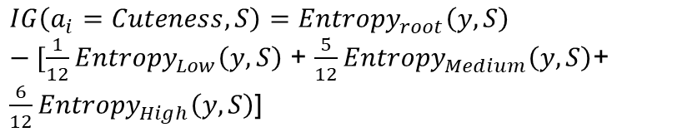
Example
Step 4
Calculate Information Gain for “Cuteness” Feature
Animal | Color | Size | Cuteness
Dog | Brown | Small | Medium
Cat | Brown | Small | Medium
Dog | Brown | Small | High
Cat | Gold | Medium | High
Cat | Black | Medium | High
Dog | Gold | Small | Medium
Cat | Brown | Medium | Low
Dog | Gold | Large | High
Cat | Brown | Medium | Medium
Dog | Black | Large | High
Cat | Gold | Large | Medium
Cat | Brown | Small | High
Cuteness |  |  | ALL
Low | 0 | 1 | 1
Medium | 2 | 3 | 5
High | 3 | 3 | 6
$IG\left(a_{i}=Cuteness,S\right)={Entropy}_{root}\left(y,S\right)−[\frac{1}{12}{Entropy}_{Low}\left(y,S\right)$ + $\frac{5}{12}{Entropy}_{Medium}\left(y,S\right)$+ $\frac{6}{12}{Entropy}_{High}\left(y,S\right)$]

Slide 18
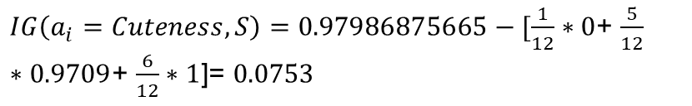
Example
Step 4
Calculate Information Gain for “Cuteness” Feature
Animal | Color | Size | Cuteness
Dog | Brown | Small | Medium
Cat | Brown | Small | Medium
Dog | Brown | Small | High
Cat | Gold | Medium | High
Cat | Black | Medium | High
Dog | Gold | Small | Medium
Cat | Brown | Medium | Low
Dog | Gold | Large | High
Cat | Brown | Medium | Medium
Dog | Black | Large | High
Cat | Gold | Large | Medium
Cat | Brown | Small | High
Cuteness |  |  | ALL
Low | 0 | 1 | 1
Medium | 2 | 3 | 5
High | 3 | 3 | 6
$IG\left(a_{i}=Cuteness,S\right)=0.97986875665−[\frac{1}{12}∗0$+ $\frac{5}{12}∗0.9709$+ $\frac{6}{12}∗1$]= 0.0753

Slide 19
Example
Step 5
Split the Data on the Feature that have the maximum Information Gain
Animal | Color | Size | Cuteness
Dog | Brown | Small | Medium
Cat | Brown | Small | Medium
Dog | Brown | Small | High
Cat | Gold | Medium | High
Cat | Black | Medium | High
Dog | Gold | Small | Medium
Cat | Brown | Medium | Low
Dog | Gold | Large | High
Cat | Brown | Medium | Medium
Dog | Black | Large | High
Cat | Gold | Large | Medium
Cat | Brown | Small | High
Color
Size
Cuteness
0.0207
0.34575
0.0753

Slide 20
Example
Step 5
Split the Data on the Feature that have the maximum Information Gain
Animal | Color | Size | Cuteness
Dog | Brown | Small | Medium
Cat | Brown | Small | Medium
Dog | Brown | Small | High
Cat | Gold | Medium | High
Cat | Black | Medium | High
Dog | Gold | Small | Medium
Cat | Brown | Medium | Low
Dog | Gold | Large | High
Cat | Brown | Medium | Medium
Dog | Black | Large | High
Cat | Gold | Large | Medium
Cat | Brown | Small | High
Size
Small
Medium
Large

Slide 21
Example
Step 6
Lets repeat all the previous steps on Every node
Animal | Color | Size | Cuteness
Dog | Brown | Small | Medium
Cat | Brown | Small | Medium
Dog | Brown | Small | High
Cat | Gold | Medium | High
Cat | Black | Medium | High
Dog | Gold | Small | Medium
Cat | Brown | Medium | Low
Dog | Gold | Large | High
Cat | Brown | Medium | Medium
Dog | Black | Large | High
Cat | Gold | Large | Medium
Cat | Brown | Small | High
Size
Small
Medium
Large

Slide 22
Example
Step 6
Animal | Color | Cuteness
Dog | Brown | Medium
Cat | Brown | Medium
Dog | Brown | High
Dog | Gold | Medium
Cat | Brown | High
Small
$IG\left(a_{i}=Color,S_{Small}\right)=0.9709−[\frac{4}{5}{Entropy}_{Brown}\left(y,S_{Small}\right)$ + $\frac{0}{5}{Entropy}_{Black}\left(y,S_{Small}\right)$ + $\frac{1}{5}{Entropy}_{Gold}\left(y,S_{Small}\right)$] = 0.1709
$IG\left(a_{i}=Cuteness,S_{Small}\right)=0.9709−[\frac{0}{5}{Entropy}_{Low}\left(y,S_{Small}\right)$ + $\frac{3}{5}{Entropy}_{Medium}\left(y,S_{Small}\right)$ + $\frac{2}{5}{Entropy}_{High}\left(y,S_{Small}\right)$] = 0.02

Slide 23
Example
Step 6
Small
Gold
Brown

Slide 24
Example
Step 6
Size
Small
Medium
Large
Gold
Brown
Worst case

Slide 25
Example
Step 6
Animal | Color | Size | Cuteness
Dog | Brown | Small | Medium
Cat | Brown | Small | Medium
Dog | Brown | Small | High
Cat | Gold | Medium | High
Cat | Black | Medium | High
Dog | Gold | Small | Medium
Cat | Brown | Medium | Low
Dog | Gold | Large | High
Cat | Brown | Medium | Medium
Dog | Black | Large | High
Cat | Gold | Large | Medium
Cat | Brown | Small | High
Size
Small
Medium
Large

Slide 26
Example
Step 6
Large
Animal | Color | Cuteness
Dog | Gold | High
Dog | Black | High
Cat | Gold | Medium
$IG\left(a_{i}=Color,S_{Large}\right)=0.9183−[\frac{0}{3}{Entropy}_{Brown}\left(y,S_{Large}\right)$ + $\frac{1}{3}{Entropy}_{Black}\left(y,S_{Large}\right)$ + $\frac{2}{3}{Entropy}_{Gold}\left(y,S_{Large}\right)$] = 0.2516
$IG\left(a_{i}=Cuteness,S_{Large}\right)=0.9183−[\frac{0}{3}{Entropy}_{Low}\left(y,S_{Large}\right)$ + $\frac{1}{3}{Entropy}_{Medium}\left(y,S_{Large}\right)$ + $\frac{2}{3}{Entropy}_{High}\left(y,S_{Large}\right)$] = $0.9183$

Slide 27
Example
Step 6
Large
Medium
High

Slide 28
Example
Data
The END
Medium
Large
Small
Size
Gold
Brown
Medium
High
Color
Cuteness

Slide 29

Try do the previous example using CART instead of Information Gain.

Slide 30

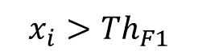
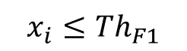
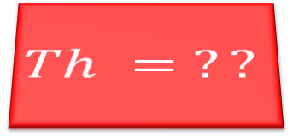
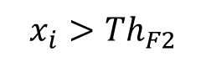
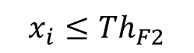
How to Split if the Feature is numerical?
F1
$$x_{i}≤{Th}_{F1}$$
$$x_{i}>{Th}_{F1}$$
$$Th = ??$$
Cat
F2
$$x_{i}≤{Th}_{F2}$$
$$x_{i}>{Th}_{F2}$$
Dog
Cat

Slide 31
How to Split if the Feature is numerical?
1
2
F1 | Target
150 | 0
160 | 1
155 | 1
149 | 1
183 | 0
170 | 0
166 | 1
F1 | Target
149 | 1
150 | 0
155 | 1
160 | 1
166 | 1
170 | 0
183 | 0
F1 | Target
149 | 1
150 | 0
155 | 1
160 | 1
166 | 1
170 | 0
183 | 0
Choose Threshold
Sort
Th =149

Slide 32
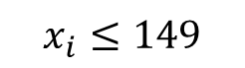

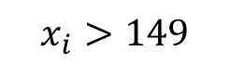
How to Split if the Feature is numerical?
F1
F1 | Target
149 | 1
150 | 0
155 | 1
160 | 1
166 | 1
170 | 0
183 | 0
$$x_{i}≤149$$
$$x_{i}>149$$
Th =149
1 One | 0 Zero
3 One | 3 Zero
3
Then we compute the Information Gain ${IG}_{Th1}$

Slide 33
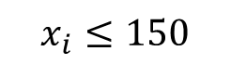

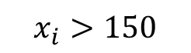
How to Split if the Feature is numerical?
F1
F1 | Target
149 | 1
150 | 0
155 | 1
160 | 1
166 | 1
170 | 0
183 | 0
$$x_{i}≤150$$
$$x_{i}>150$$
Th =150
1 One | 1 Zero
3 One | 2 Zero
3
Then we compute the Information Gain ${IG}_{Th2}$

Slide 34
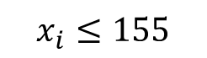

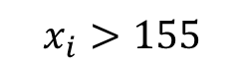
How to Split if the Feature is numerical?
F1
F1 | Target
149 | 1
150 | 0
155 | 1
160 | 1
166 | 1
170 | 0
183 | 0
$$x_{i}≤155$$
$$x_{i}>155$$
Th =155
2 One | 1 Zero
2 One | 2 Zero
3
Then we compute the Information Gain ${IG}_{Th3}$

Slide 35
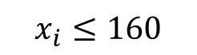

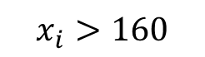
How to Split if the Feature is numerical?
F1
F1 | Target
149 | 1
150 | 0
155 | 1
160 | 1
166 | 1
170 | 0
183 | 0
$$x_{i}≤160$$
$$x_{i}>160$$
Th =160
3 One | 1 Zero
1 One | 2 Zero
3
Then we compute the Information Gain ${IG}_{Th4}$

Slide 36
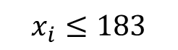

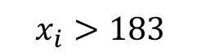
How to Split if the Feature is numerical?
F1
F1 | Target
149 | 1
150 | 0
155 | 1
160 | 1
166 | 1
170 | 0
183 | 0
$$x_{i}≤183$$
$$x_{i}>183$$
Th =183
4 One | 3 Zero
0 One | 0 Zero
3
Then we compute the Information Gain ${IG}_{Th7}$

Slide 37
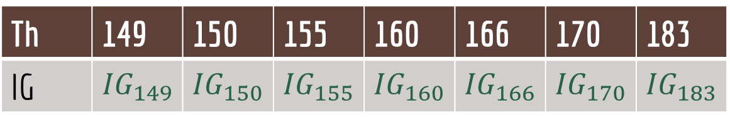
How to Split if the Feature is numerical?
F1 | Target
149 | 1
150 | 0
155 | 1
160 | 1
166 | 1
170 | 0
183 | 0
Th | 149 | 150 | 155 | 160 | 166 | 170 | 183
IG | $${IG}_{149}$$ | $${IG}_{150}$$ | $${IG}_{155}$$ | $${IG}_{160}$$ | $${IG}_{166}$$ | $${IG}_{170}$$ | $${IG}_{183}$$
Choose the Th that Maximize Information Gain
4

Slide 38
Advantages | Disadvantages
Interpretability | Overfitting
Less Data Preparation | High variance models
Non-Linearity

Slide 39
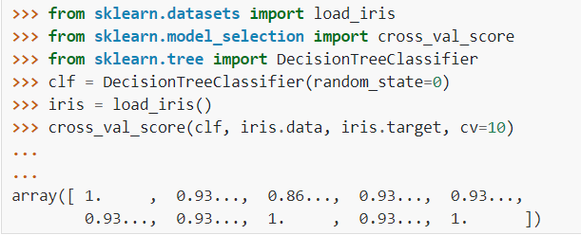
Decision Tree Using SkLearn
https://scikit-learn.org/stable/modules/generated/sklearn.tree.DecisionTreeClassifier.html

Slide 40
Important parameters
max_depth | The maximum depth of the tree
min_samples_split | The minimum number of samples required to split an internal node
max_leaf_nodes | The maximum number of leaf nodes
max_features | The number of features to consider when looking for the best split
class_weight | To handle unbalance data
https://scikit-learn.org/stable/modules/generated/sklearn.tree.DecisionTreeClassifier.html

Slide 41
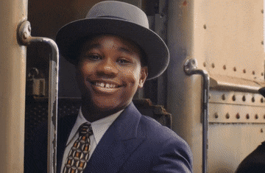
Thank you for listening

Slide 42
Any Questions
?

